Slide 1
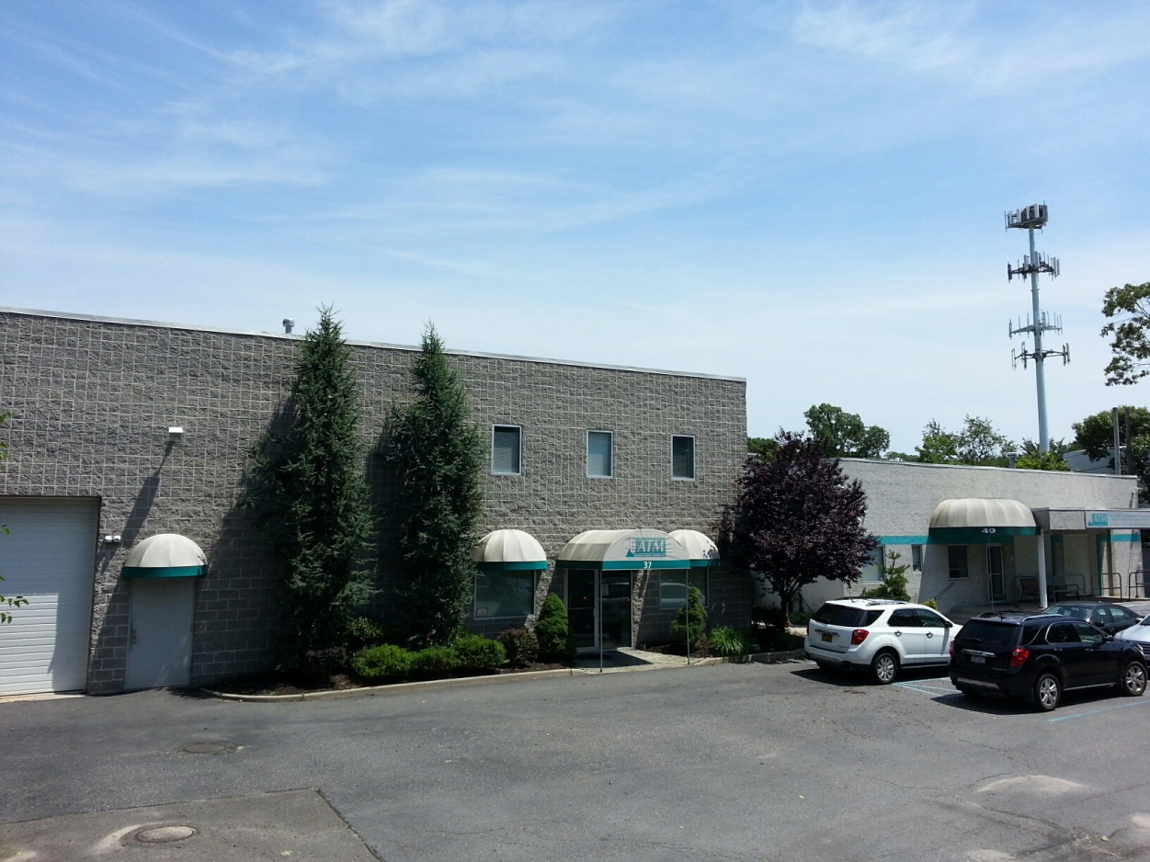
FACILITIES & EQUIPMENT
Advanced Technical Materials, Inc.
49 Rider Ave
Patchogue, N.Y. 11772

Slide 2
About ATM ATM manufactures flight qualified waveguide , high performance microwave components used in satellites, radar systems, telecommunications and high tech medical systems and more
ATM Product Lines
ATM Capabilities
ATM Designs, Manufactures, & Stocks:
Flight Qualified Waveguide Assemblies and Runs
Coaxial Components including: • Continuously Variable Attenuators • Phase Shifters • Power Dividers & Combiners • Directional Couplers • Fixed Attenuators • Terminations • Hybrids • Coaxial Switches (Electromechanical and Solid State
Waveguide Components including: • Transitions • Waveguide to Coaxial Adapters • Loop Directional Couplers (Double Ridge Mainline and Coaxial Coupled Output) • Misc. Custom Components to your specifications • Waveguide Assembly • Complete Sub-Assemblies • Custom Designed Components • Double Ridge W/G Components
Total of 13 CNC Milling Machines with 4th axis capability
CNC and manual Lathe capability
4 manual milling machines
ATM's Microwave measurement capability up to 50GHz makes us the best choice for the design and manufacturing of your components.
Our in house design team, expert manufacturing, inspection and quality control capabilities, allow fast response to our customer requirements.
High quality, exacting standards and excellent workmanship make it easy for ATM to qualify as a your source for all your microwave needs.

Slide 3
Engineering Department Our expert design engineers use the latest cad software throughout the manufacturing process to insure the highest precision and superior performance for both static and dynamic parts.

Slide 4
Advanced CAD Design
The ATM Design Team
FULL DESIGN REVIEW BEFORE PRODUCTION
ATM's Design Engineers will work with you to make sure that our products not only meet your specifications, but will do the job right the first time.
Our highly trained Design Engineers and Knowledgeable Staff can help you design just the right custom components to meet your needs.
After designing your custom components and systems, we have comprehensive capabilities to manufacture your products on the premises for fast turnaround.
Our Design Teams and Manufacturing Personnel will handle single piece and small quantity jobs that the other guys won't touch.
We do it with the same precision, excellent craftsmanship, and attention to detail that we give to our largest orders.
Give us your most challenging projects, and you will quickly see why our design team is the best!

Slide 5
Advanced CAD Design ATMs’ engineering department is constantly working on new designs that accommodate a broad spectrum of end users. ATM strives for quality, and it all starts with sales and marketing and then CAD design
WRD180 Horn with adapter machined in two half's
Completed product with superior performance

Slide 6
Advanced CAD Design Generate Manufacturing Drawings for Flight Waveguide from IGES and STP files

Slide 7
State Of The Art CNC Machine Shop
ATM's CNC machining capabilities are among the most advanced in the RF microwave industry.
Our manufacturing expertise allows us to produce lightweight components for satellites that are reliable with high performance and long life.

Slide 8
Electrical Testing ATM is equipped with the latest model VNA’s to handle the current capacity needed for 100% inspection of all components and flight waveguide assemblies.
Vector star VNA Tuning flight Waveguide
VNA used in QC for 100% final inspection

Slide 9
Lab and Electrical Assembly
Phase shifter cycling to ensure repeatability & reliability
Coax adapters at the assembly and testing level

Slide 10
Lab and Electrical Assembly
Generator with noise figure meter
Soldering chip resistors

Slide 11
Inspection Equipment
30X MAGNIFICATION WITH extended focal point microscopes USED IN BOTH PRODUCTION AND qc
24” precision height gages

Slide 12
Inspection Equipment
Borescope inspection
Looking inside a flight WG 90° H-Miter

Slide 13
Inspection Equipment Mechanical inspection stations with 3D viewing capability

Slide 14
Finishing Department with In-House Chemical Conversion Coating Capability

Slide 15
In-House Paint Department
Fully ventilated paint booth
Paint oven

Slide 16
Marking Department
Automated inkjet marking machine
Used to handle a large volume of parts
Replaced hand stamping of flight WG
Capable of sequential serializing of parts

Slide 17
Flight Waveguide
KA band multi-miter assembly
WR229QH WG with bends and twists

Slide 18
Flight Waveguide
WR229QH WG with bends and twist
WR34 with flexible WG, bends and twist

Slide 19
Added Processing steps to flight waveguide Including new equipment
ATM has added a borescope inspection point post braze and prior to any surface plating of the aluminum
Microscopes have been added at two locations.
Post braze mechanical inspection
QA inspection before surface plating
Heat treating and hardness testing
ATM has added and was approved by MDA to perform heat treating in accordance with work instructions WI03.301 Rev B
Purchased Barber Coleman Model GYZ J 934-1 to test the Rockwell E hardness of 6061 aluminum after heat treat
Etching process
The etching process is now used to ensure the interior of the waveguide is free from brazing flux, stop off and any residuals left behind from the brazing process
Etching also diminishes scoring marks that may be present after the bending or twisting process
Electrical verification and nitrogen purge
This is used during final QC inspection to ensure the part meets the required specifications prior to shipment
The nitrogen purge is performed just prior packaging and shipping to eliminate any residual moisture that may be present

Slide 20
ATM Quality Control
Advanced Technical Materials Inc. is an industry leader with a quality control system that is ISO certified, and customer audited. All components are fully tested and inspected mechanically and electronically prior to shipment. Advanced Technical Materials is a "Certified" supplier to many large Prime Contractors.
Certification
ATM has been customer audited and is compliant with PQA-005B and MIL-STD-45662 to manufacture Space Qualified Waveguide Assemblies.

Slide 21
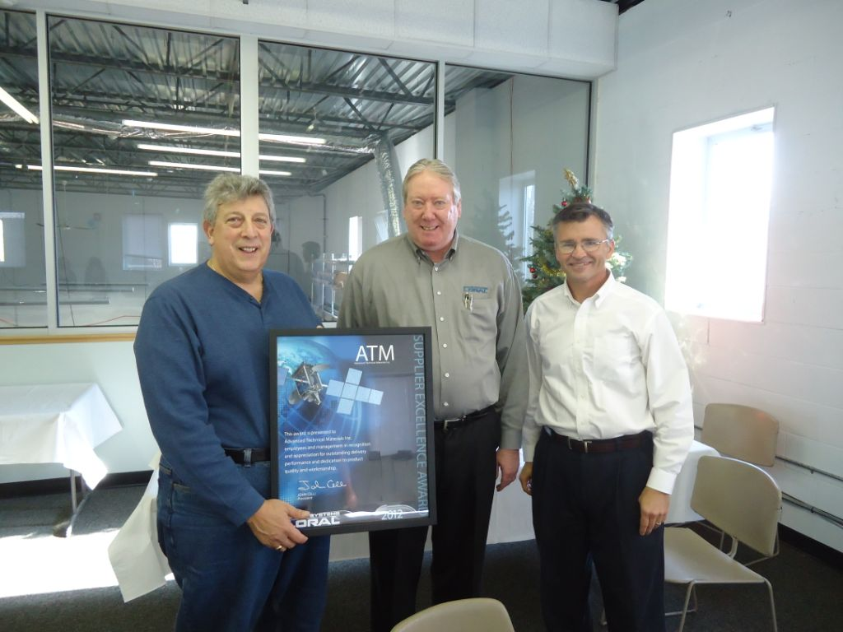
SSL Recognizes ATM's Superior Performance
Our attention to quality control and on time delivery have won numerous awards from our customers including SSL (formerly Space Systems/Loral). In 2012, Space Systems Loral awarded ATM their supplier excellence award for our record of 100% on time delivery, with a quality rate of 99.6%.

Slide 22
SSL Customer Certified Inspection Program (CCIP)
In 2013, SSL recognized our high quality and superior performance by granting ATM the prestigious honor of Self Certification Status. Of the 300 SSL space systems suppliers, only 4 are Self-Certified. We are extremely proud that ATM is one of them.

Slide 23
Summary
ATM has been providing flight qualified waveguide for many years and has proven to be a leader in the industry with supplying thousands of flight qualified waveguide while maintaining excellent quality and delivery with consistency
ATM has added processing steps to make products that will meet the requirements that all of our customers expect for our flight qualified product line and all of our products we manufacture
Even with winning supplier awards for quality, delivery and certified source inspection programs from some of our customers, we are always willing to improve our processes to make a superior product that meets the needs of our customers

Slide 24
